Slide 1
Association between depression and poverty
Daniel lagos
Ana 500
October 9, 2022
https://github.com/danlagos/ANA500---Week-2

Slide 2
Problem statement
Background: Using California Health Interview Survey (CHIS) 2020 to search for an quantify the association between depression and poverty levels after controlling for general health, and current smoking habits in adults in the state of California.
Objective
How does poverty levels affect depression in adults?
What are the effects of general health and smoking habits, and do they interact with poverty levels?
Cam a machine learning model predict depression based on poverty levels after accounting for general health, and smoking habits?

Slide 3
Hypothesis formulation
H₀: There is no statistically significant association between depression and poverty levels after controlling for general health, and current smoking habits
H_{A}: There is a statistically significant association between depression and poverty levels after controlling for general health, and current smoking habits

Slide 4
Top-down program design
Overall Task: Develop Python program that takes CHIS 2020 as input (poverty, general health, smoking habits) and outputs predicted effect on depression levels.
VAR AJ32: captures results of survey question “Feeling depressed in the past 30 days?
VAR AJ32 is categorical, numeric. Coding provided in visualization section
Steps to take
Acquire: identify data set, retrieve data, query data. CHIS has already been selected. Currently in SAS XPT format.
Prepare: analyze codebook, explore and process data using python and discovery from codebook.
Analyze data: select analytical technique, build model
Report: communicate results – not inclusive to code development
Act: apply results, connect results with problem statement – not inclusive to code development

Slide 5
Hierarchy chart
DEPRESSION = CHIS2020DATASET(POVERTY, GENERAL HEALTH, SMOKING)
Main Program( output depression, input CHIS dataset with variables for poverty levels, general health, and current smoking habits)

Slide 6
Flow chart
Start
Load data
Preliminary analysis: ID data set features, statistically describe data
Visualize: Plot each feature against output variable (depression) to understand data
Clean Data: handle missing values

Slide 7
pseudocode
# Start
# STEP 1 Acquire data: from CHIS website
# Import libraries: pandas, NumPy, seaborn, matplotlib
# Read dataset: import data. Must read in SAS XPT file into Python
#STEP 2: Prepare – conduct analysis of codebook – identify appropriate variables, and determine structure
# read data: data.head(), data.info()
# Format data: create new data set with appropriate variables– SMOKING, AB1, POVLL, AJ32
# Remove inappropriate values – AJ32(Variable for depression) contains value of -2 (means proxy skipped). Not applicable, remove.
# Visualization: make histograms, scatter plots and bar charts, use as appropriate.
End program

Slide 8
Acquire
Data set was acquired via CHIS website (https://healthpolicy.ucla.edu/chis/data/pages/getchisdata.aspx). This is a well respected and well cited survey repository that conducts surveys to delve into California's public health issues.
CHIS website proved extensive codebook to assist in analysis and will be relied upon for the data preparation of this project.

Slide 9
prepare
Codebook identifies AJ32, variable for depression with value of -2, meaning proxy missing.
All other variables are categorical numeric

Slide 10
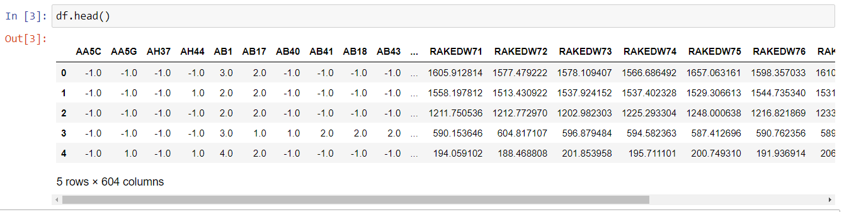
prepare

Slide 11
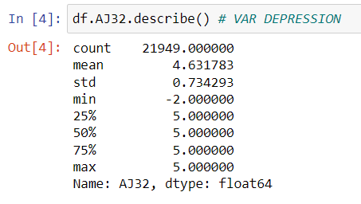
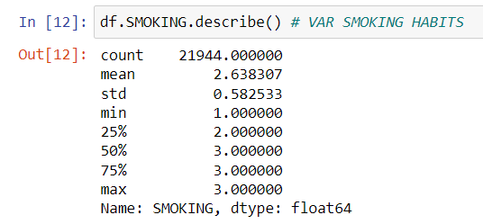
prepare
Confirming that no other variables contain unusable values. AJ32 with values of -2

Slide 12
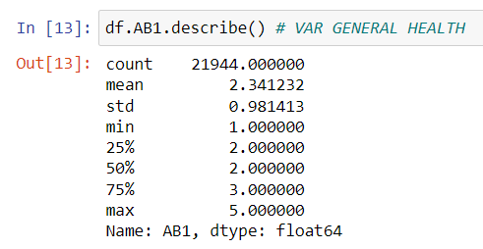
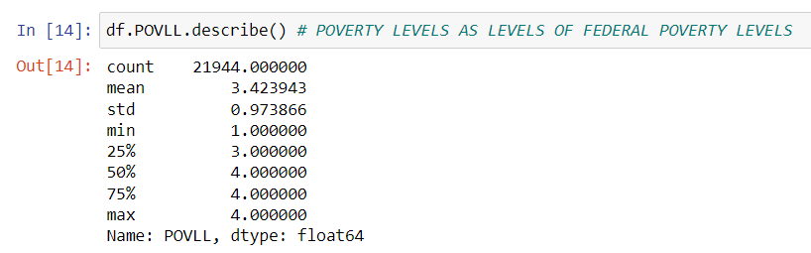
PREPARE
Confirming that no other variables contain unusable values

Slide 13
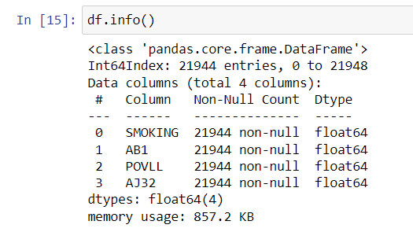
PREPARE
Confirming lack of missing values

Slide 14
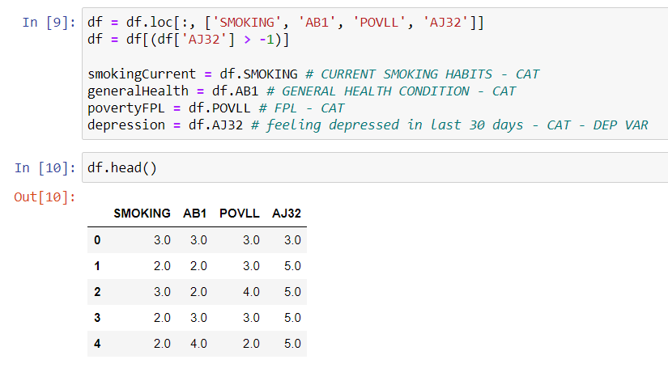
prepare
Clean data

Slide 15
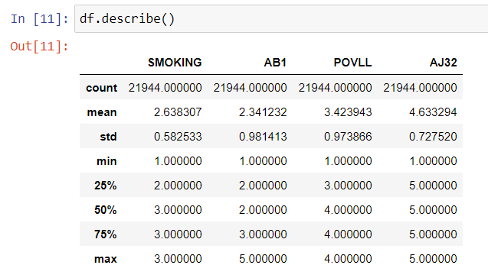
prepare
Confirming data set is clean: all values over 0, n= 21,944, devoid of variables not in use.

Slide 16
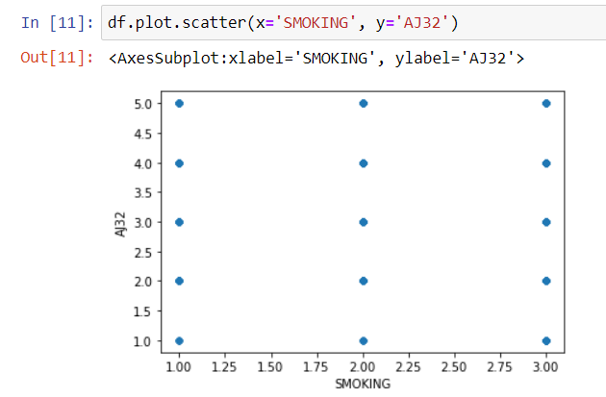
Prepare - visualization
After conducting data.hist(), data.scatter() and data.plot.box() it has been determined that scatter plots are inappropriate: example of output of scatter plot for smoking vs depression levels, below. All other scatter plots provide similar results, and not insightful, therefore not used.

Slide 17

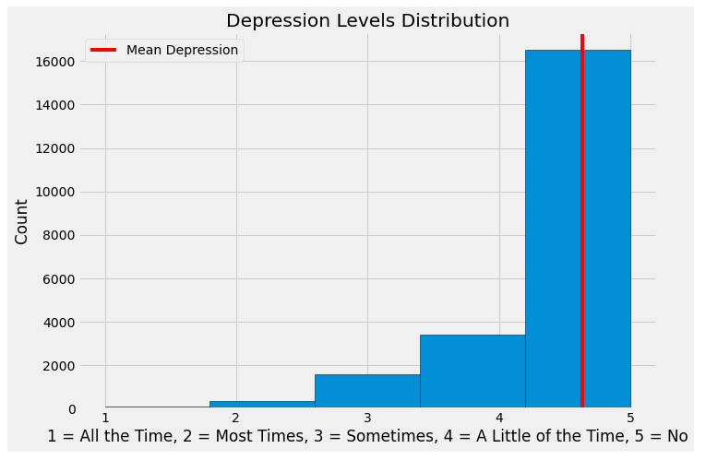
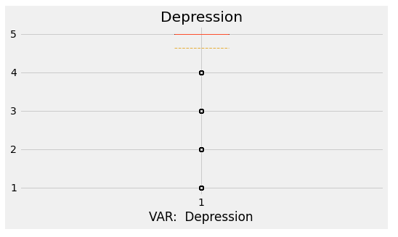
Prepare - visualization
Histogram of dependent variable DEPRESSION. Left Skew.
AJ32: Feeling depressed in the past 30 days?
Coding:
1 = all the time
2 = most of the time
3 = some of the time
4 = a little of the time
5 = not at all

Slide 18
Prepare - visualization
Observations - DEPRESSION: Very difficult to determine much from the box plot. This may be because in the histogram it appears as if there are relatively few people that are depressed compared to those that are not depressed.
Histogram shows left skew, meaning the distribution is not normal. Need to keep this in mind if using an algorithm that assumes normal data.

Slide 19
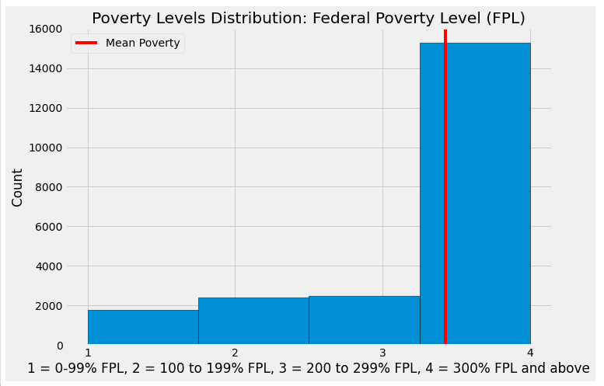
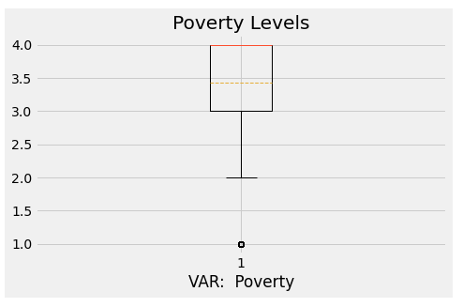
Prepare - visualization
Histogram & Boxplot of POVERTY,. Left Skew.
Federal Poverty level (FPL)
Coding
1 = 0-99% FPL
2 = 100 to 199% FPL
3 = 200 to 299% FPL
4 = 300% FPL and above

Slide 20
Prepare – visualization
Observations – POVERTY: Distribution is not normal. Merely pointing out if an algorithm is used that assumes normal distribution.
Histogram and boxplot confirms skew, confirming lack of normality in distribution
Income is generally ordinal, because poverty levels is based on Federal Poverty Levels, which is a measure of income, this distribution may have an ordinal component. This may determine the type of algorithm, or may require specific testing.

Slide 21
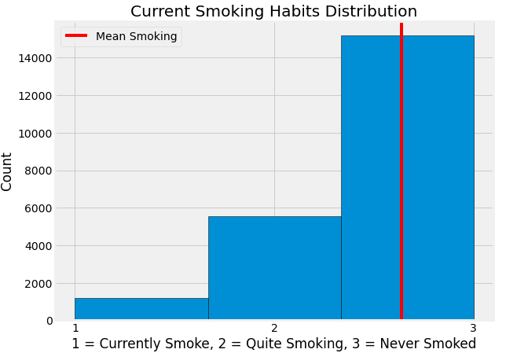
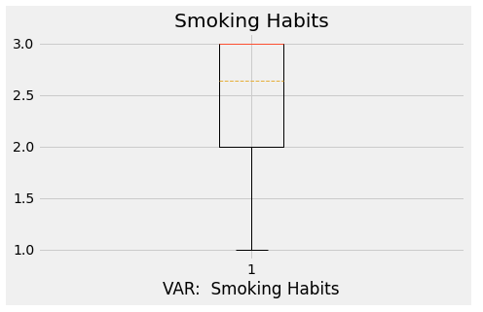
Prepare - visualization
Histogram & Boxplot of SMOKING. Left Skew.
Current smoking habits
Coding
1 = currently smokes
2 = quite smoking
3 = never smoked regularly

Slide 22
Prepare – visualization
Observations – SMOKING: As before, histogram and box plot shows left skew. This is not as important as this is not out exposure variable.

Slide 23
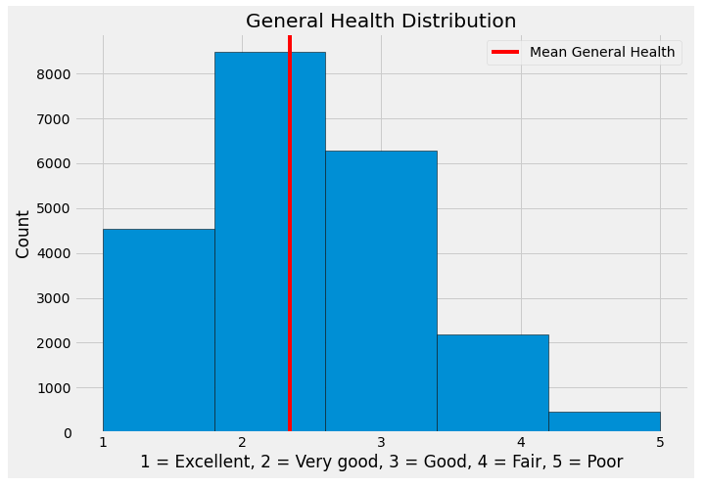
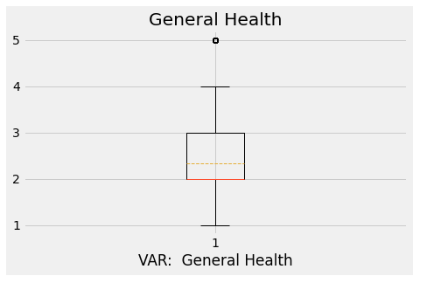
Prepare - visualization
Histogram & Boxplot GENERAL HEALTH, either right skew or might be normal. Difficult to determine.
General Health Condition
Coding
1 = excellent
2 = very good
3 = good
4 = fair
5 = poor

Slide 24
Prepare – visualization
Observations – GENERAL HEALTH: Boxplot and Histogram show that distribution may be normal.

Slide 25
Prepare – visualization
General Observations based on visualizations We are not too concerned about possible lack of normal distributions to the data. We only worry about this if using an algorithm that requires normal distribution. Right now, the possible lack of normality is merely noted. We only need to act upon this if the algorithm used calls for data with normal distributions.
POVERTY may be ordinal. Again, this is not a problem right now, but must be noted when determining the type of algorithm to use.
N = 21,944: This should be sufficient to run an analysis.
All our data is categorical. It may make sense to transform the data into binary forms to simplify the model and reduce computational power. However, there are only 4 variables in total, with 3 to 4 levels. The resulting model, and computational power required to train model may not be that complex. For now, no changes will be made to structure of data.

